Slide 1


Soapy or Scrumptious: Cilantro Preference
Population structure analysis using SNPs
BIO392
Ayesha Gerber
Sarah Loose

Slide 2



Intro
What do you associate Cilantro taste with?
Heritable Hate: -> twin studies show dislike might depend on genetic variations and predispositions
Gene Candidates determining cilantro dislike:
OR6A2 | TAS2R1 | OR4N5
Receptor, highly sensitive to aldehyde chemicals | Bitterness receptor | Odorant receptor
Notes:
We focused on 3 genes highlighted in 2 studies that were associated with determining cilantro preference
Both use genotyping
OR6A2 olfactory receptors, most promising candidate, identified via 23andME https://doi.org/10.1186/2044-7248-1-22
TAS2R1 bitterness receptor, https://www.uniprot.org/uniprotkb/Q9NYW7/entry
OR4N5 odorant receptor, https://www.uniprot.org/uniprotkb/Q8IXE1/entry#function
Further sources:
https://doi.org/10.1093/chemse/bjs070 twin studies show hints that olfactory perception is heritable

Slide 3

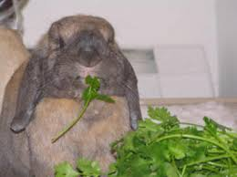

Data & Project Goal
Biallelic SNVs Data (VCF format) from the 1000 Genome Project, published 2018
Can we find preference patterns in cilantro preference based on ancestry inferred from SNVs?
Notes:
To determine whether candidate genetic markers associated with cilantro
preference differ between ethnocultural groups.
Biallelic: allel from mother and father

Slide 4
Analysis Workflow
VCF file --> PLINK convert --> LD Pruning --> PCA analysis -- > ADMIXTURE Analysis
PLINK convert: filter our genomic region of interest and convert .vcf to .bed file (Data processing)
Linkage Disequilibrium Pruning: remove SNPs with high linkage disequilibrium to prevent bias and remove redundancy (Data processing)
PCA: linear orthogonal transformation reducing dimensionality retaining components explaining the greatest variance (Visualization)
ADMIXTURE: maximum likelihood method to infer ancestry proportions of an individual (Anscestry Inference)
Notes:
LD: nonrandom association of alleles at multiple DNA markers that results from their close proximity to one another within a chromosome and co-inheritance.
Window size (50): Prune SNPs in windows of 50 consecutive markers.
Step size (1): The window slides by one SNP at a time.
r² threshold (0.1): Remove one of two SNPs if their pairwise r² value is greater than 0.1.
PCA: find patterns. People with similar ancestry will cluster together.
PLINK is a free, open-source whole genome association analysis toolset, designed to perform a range of basic, large-scale analyses in a computationally efficient manner. https://www.cog-genomics.org/plink/1.9/
ADMIXTURE estimates how much of each person's DNA comes from K ancestral populations
Admixture: optimization algorithm useing log-likelihood to maximize likelihood function to predict accurate ancestry proportions
"With admixture proportion inference, individuals in a sample are modeled as having a proportion of their genome derived from each of several source populations. The goal is to infer the proportions of ancestry from each source population, and these proportions can be used to produce compact visual summaries that reveal the existence of population structure in a sample." https://link.springer.com/protocol/10.1007/978-1-0716-0199-0_4

Slide 5
LD Pruning – Why and How?
Nonrandom association of alleles at multiple DNA markers that results from their close proximity to one another within a chromosome and co-inheritance.​
make the analysis more robust, avoiding bias by redundant information
We give 3 values into the command line
plink2 --bfile chr11_fix \ --indep-pairwise 50 10 0.1 \ --out ld_chr11
50: window size of SNPs
10: step of frame shift
0.1: r² threshold tolerated (how correlated are the SNPs, pairwise correlation between 2 SNPs in the sliding window)

Slide 6
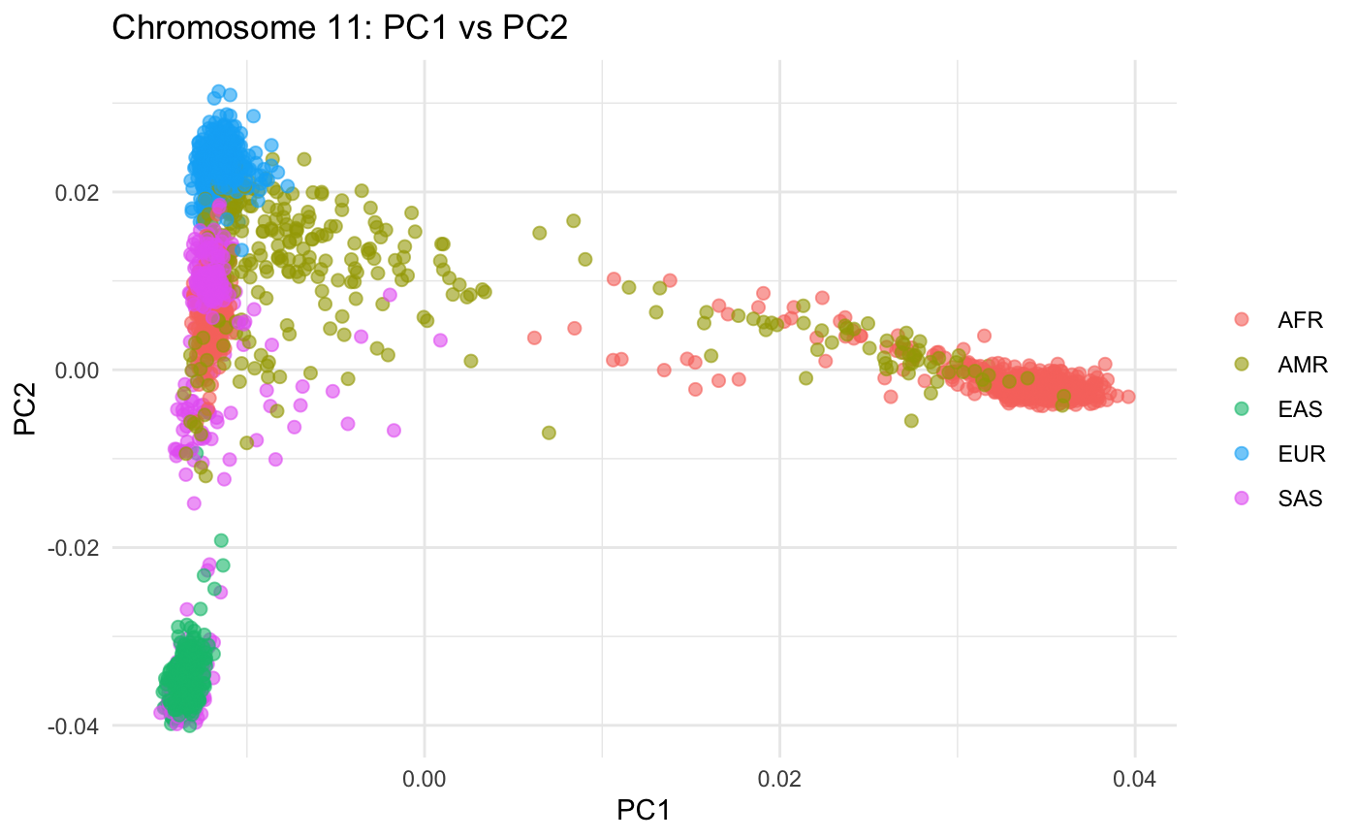
PCA - Making Complex Data Simpler
Every person has thousands of SNPs
PCA reduces this huge amount of information into just a few variables
-> principal components
It allows us to plot people as points, based on how genetically similar they are.
Whole chromosome 11. We see SNP variance between the superpopulations. Nothing inferable about cilantro.
We used PCA to see if people with different ancestry also differ in the genes linked to cilantro taste.

Slide 7
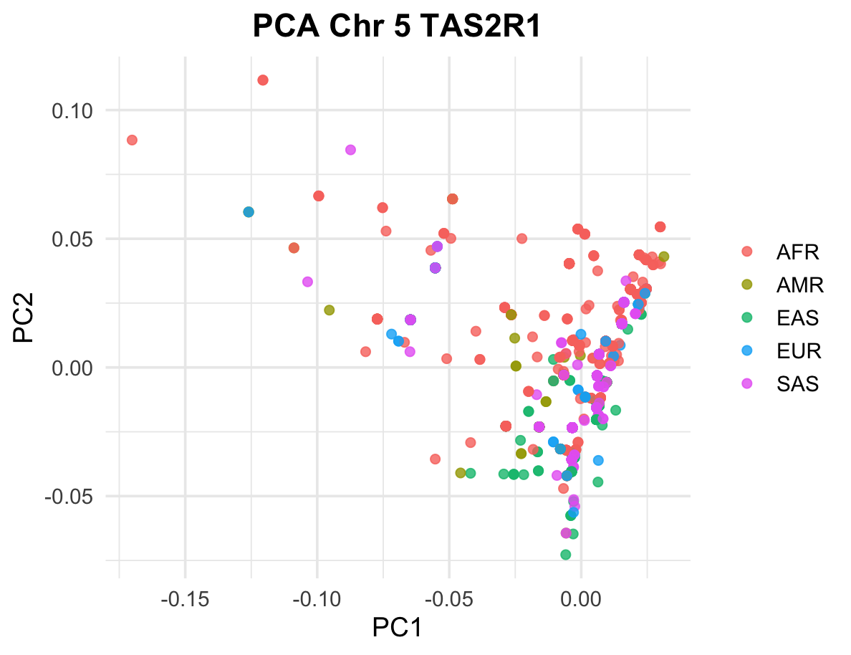
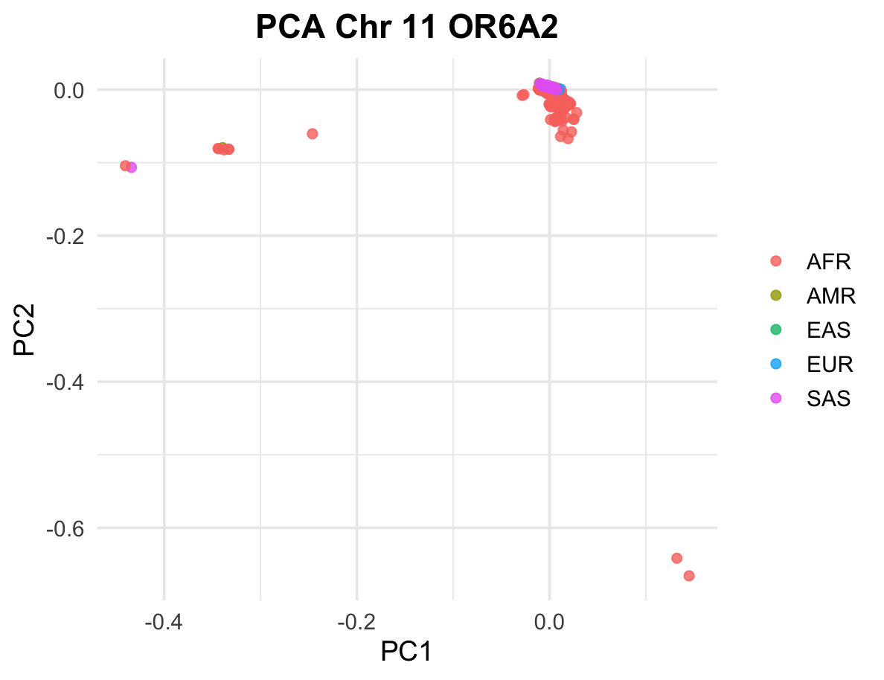
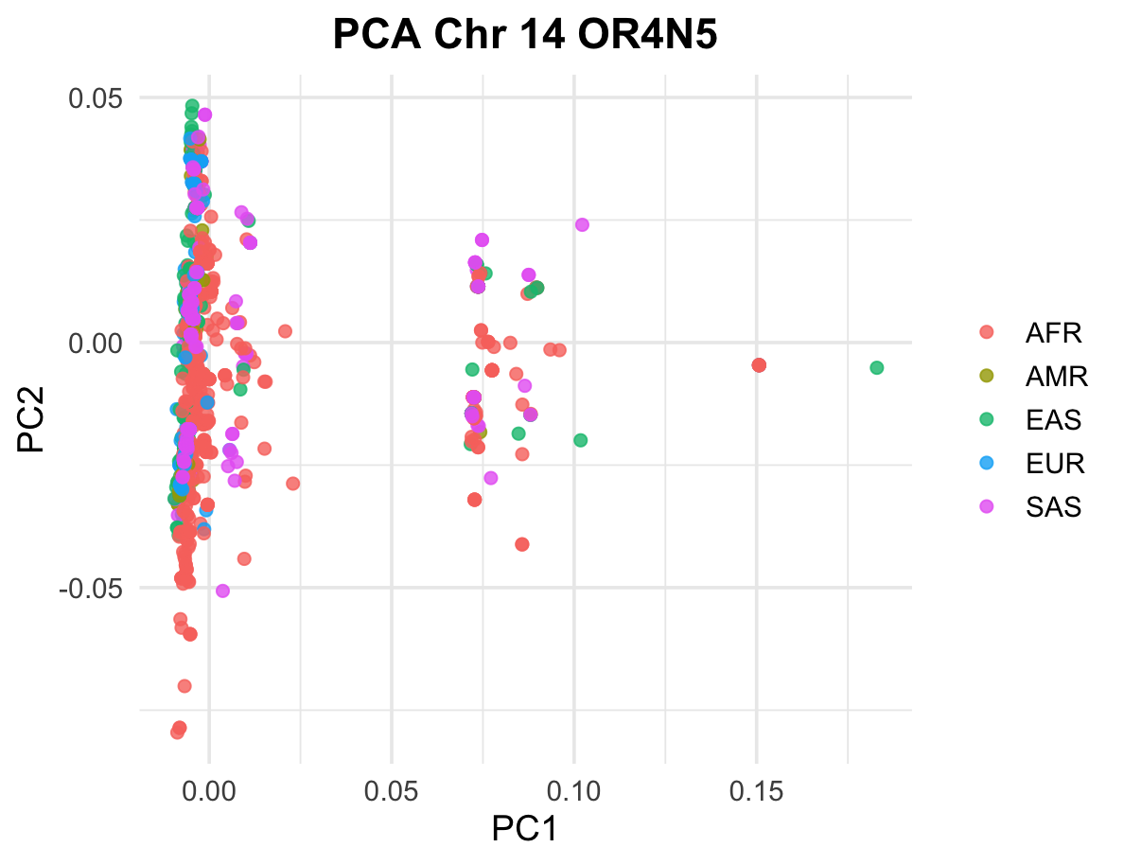
Results: PCA
Some minor clustering tendencies, but overall overlap between populations
Low number of SNPs leads to weak differentiation and no clear structure.
Functional SNPs may exist, but they do not create population-wide structure.

Slide 8
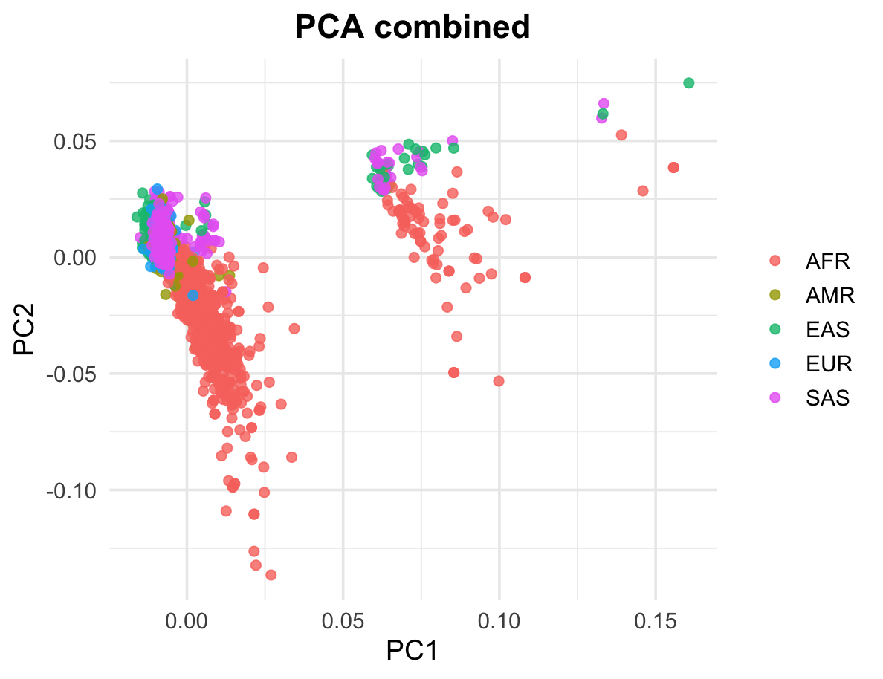
Results: PCA
Three loose groupings
Could reflect gene differences
Within each cluster, population structure is slightly reflected:
EUR, SAS, and EAS tend to cluster together.
AFR individuals appear more spread out.
pattern could reflect regional variation across the three loci
overall structure is still weak
Notes:
610 SNPs
2548 Personen

Slide 9
ADMIXTURE – Infer Population Structure
Input:
SNP Data of all individuals
K = number of ancestral populations the model will infer
Process:
Maximum likelihood estimation to:
Determine each individuals proportion of the genome from each of the K ancestral populations
Match allele frequency for each SNP to one K ancestral population
Try several runs to find best K (using cross-validation)
Output:
.Q file (ancestry proportions per individual) -> visualization
.P file (allele frequencies per population)
Notes:
MLE: method to find the most likely parameters (like ancestry proportions or allele frequencies) that would make the data we observe most probable by an assumed probebility distribution. This is achieved by maximizing a likelihood function so that, under the assumed statistical model, the observed data is most probable
Likelihood: A measure of how probable your data is given a model.
Cross validation: evaluate how well a model generalizes to new, unseen data. It helps prevent overfitting (where a model performs well on training data but poorly on new data) -> unsupervised learning

Slide 10
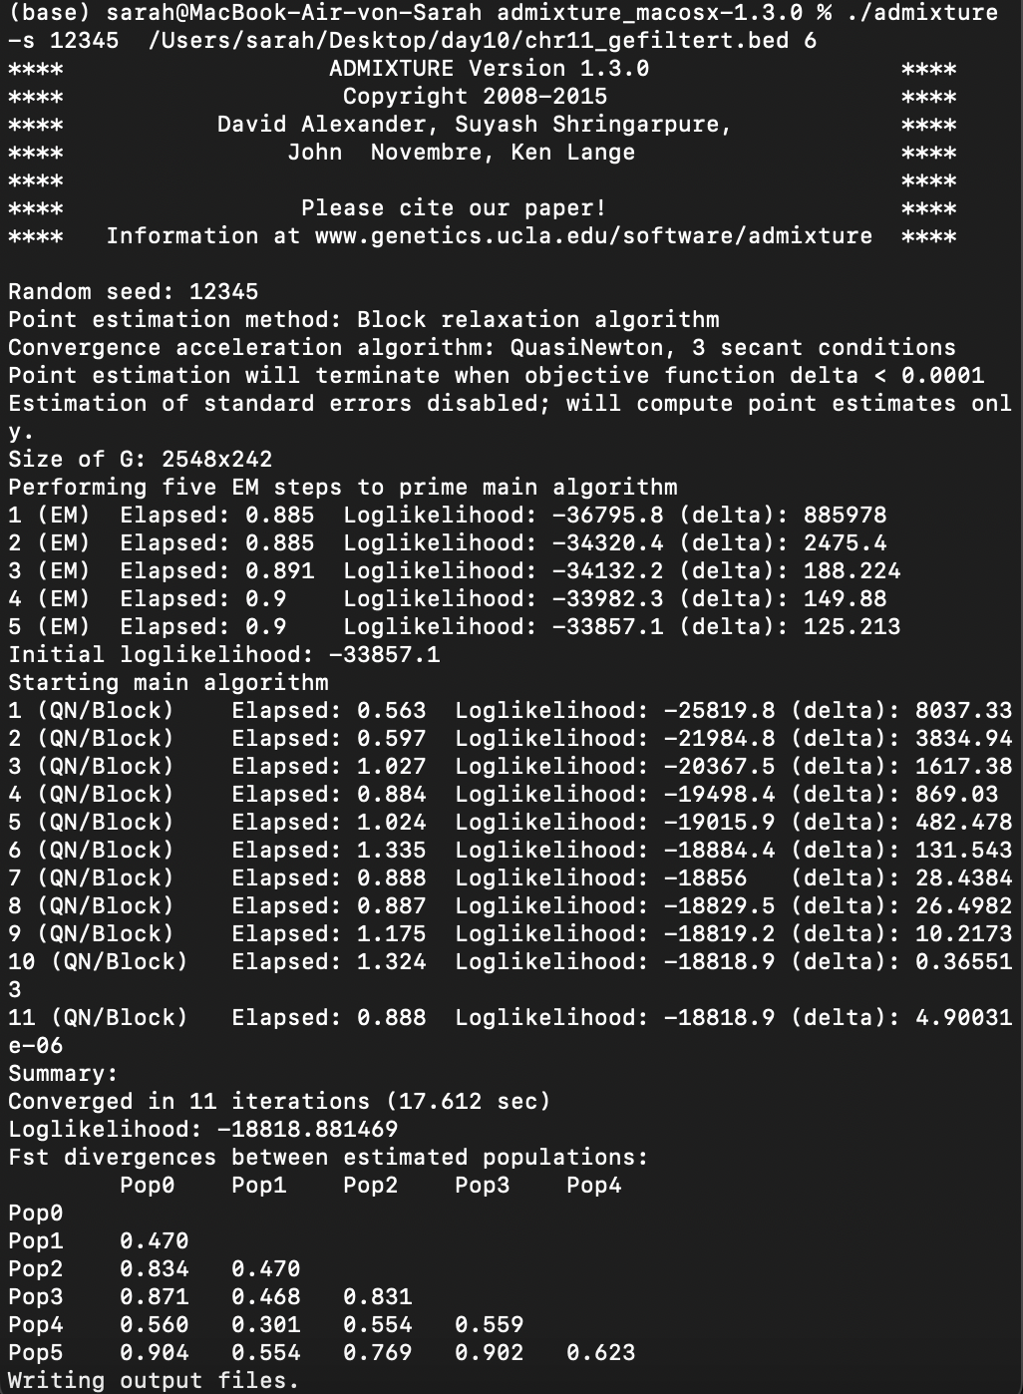
ADMIXTURE RUN
Set arbitrary K (an. pop.)
Set random seed for reproducibility
Expectation Maximization:
Iterative, find biggest Log-likelihood fast
Quasi-Newton Algorithm
Iterative Log-likelihood optimization
Fst Divergence Matrix
How different are the K populations based on allele frequency
Write .Q and .P files
Notes:
Command line
Delta: difference between log likelihoods, to find convergence (smaller steps)
Expectation (E-step) and the Maximization (M-step) steps to find the parameters that maximize the likelihood of the data.
Fst: high value: distinct populations low value: not very distinct
.P file
Each row is a SNP, and each column (out of K) tells you the frequency of a certain allele in one ancestral population.
Size: L × K (L = number of SNPs)

Slide 11
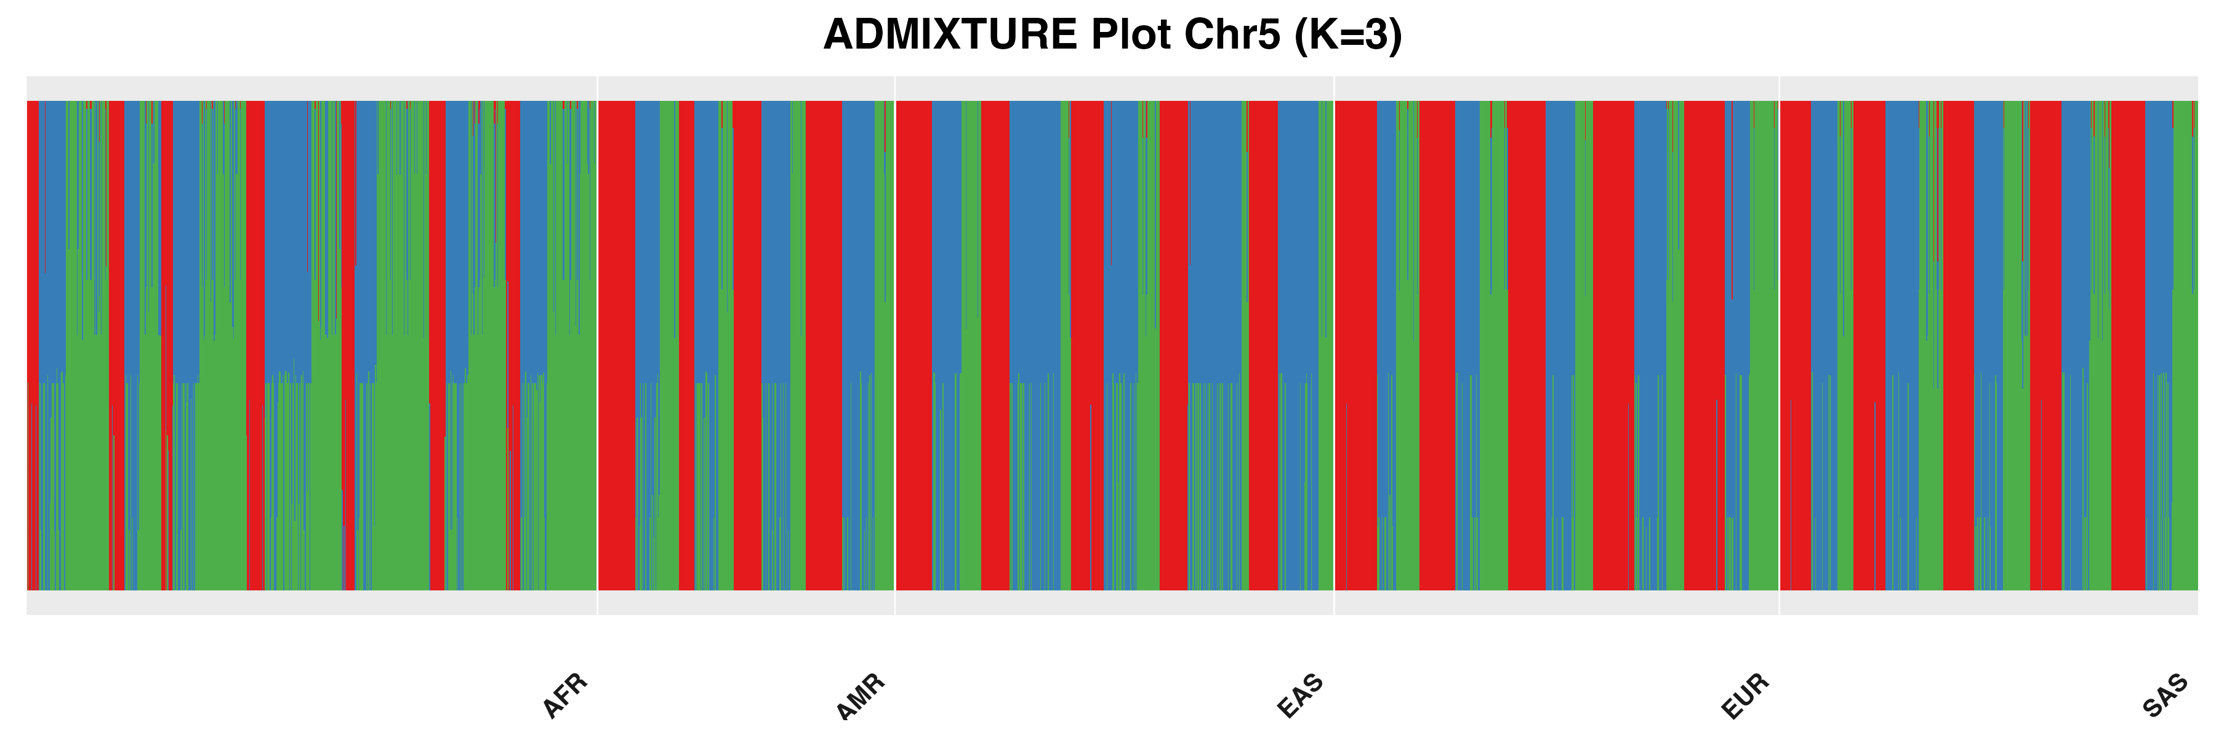

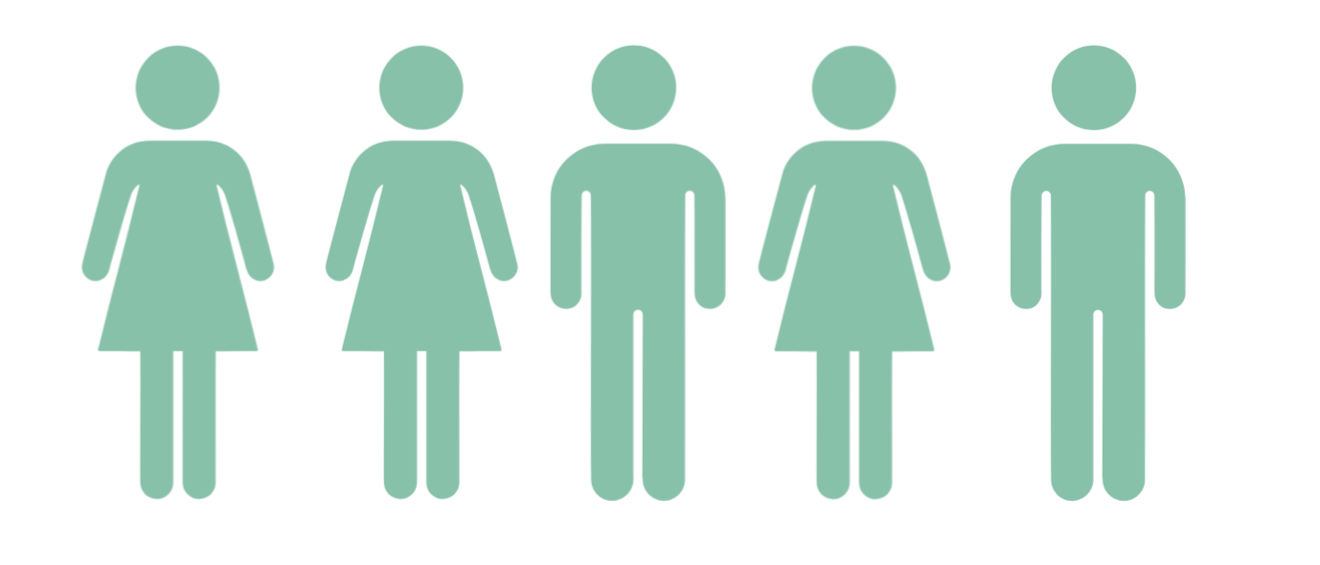
Visualization from .Q file
% Population A
% Population B
% Population C
Notes:
Shows genomic landscape
.Q file (e.g., chr14prune.6.Q)
for plots.
Each row is an individual, and each column is their estimated proportion of ancestry from each of the K populations. Value between 1-0
Size: N × K (N = number of individuals, K = ancestry protoprtion)

Slide 12
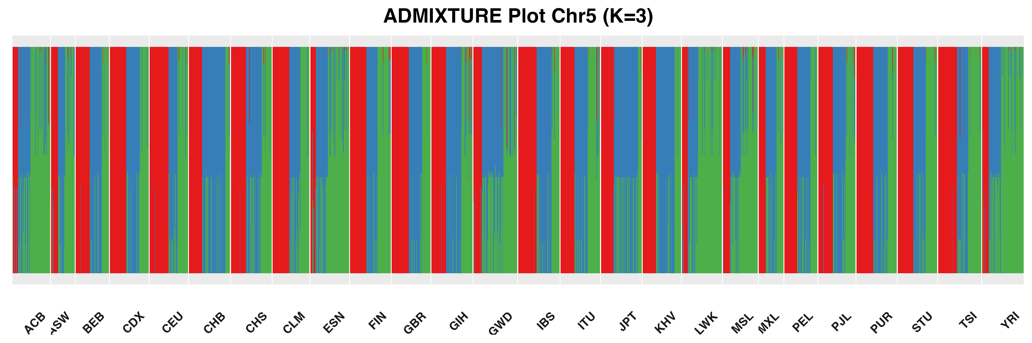
Results: ADMIXTURE
highly mixed ancestry components across all populations.
No clear population-specific clustering is visible.
AFR shows slightly more green, but the difference is minimal.
Too few SNPs and insufficient variation in this region to detect population structure.
Notes:
CV error (K=2): 0.03823
CV error (K=3): 0.03540 -> Best
CV error (K=4): 0.04916
CV error (K=5): 0.04908
CV error (K=6): 0.04951
CV error (K=7): 0.04165
CV error (K=8): 0.03723
CV error (K=9): 0.05447

Slide 13
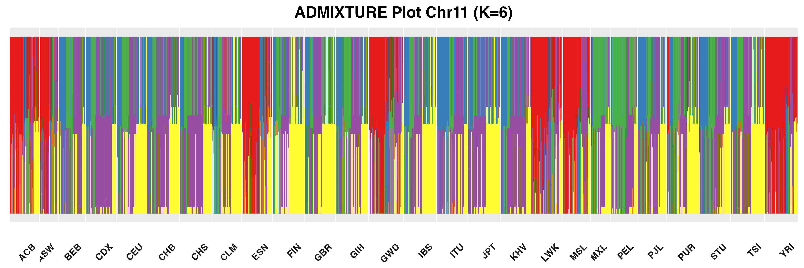
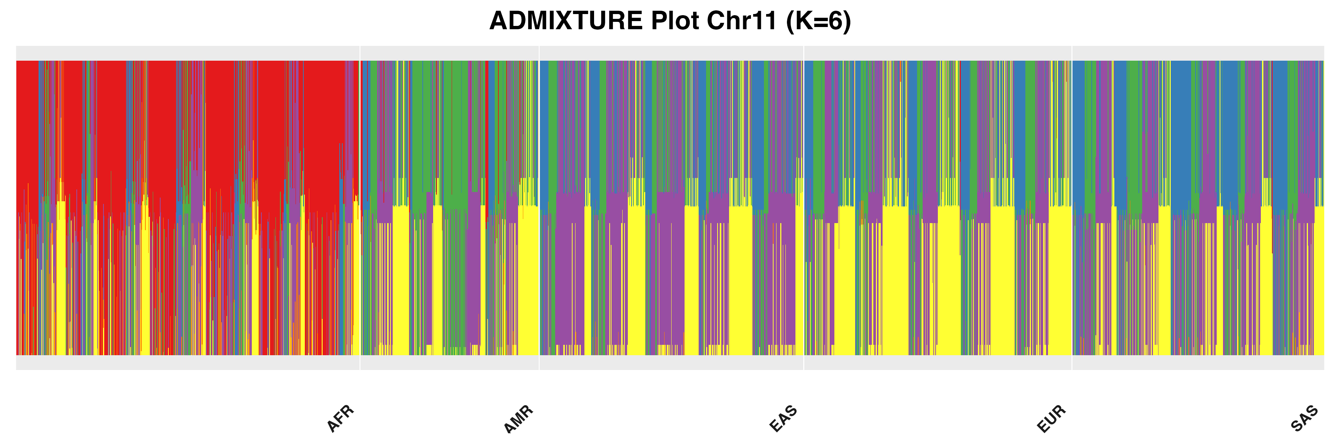
Results: ADMIXTURE
Individuals show highly fragmented ancestry proportions with all six clusters spread across populations.
AFR appears slightly more red, but overall patterns remain inconsistent.
The region is functionally relevant for cilantro perception, but genetically not informative for population structure.
Notes:
CV error (K=2): 0.02994
CV error (K=3): 0.02587
CV error (K=4): 0.02162
CV error (K=5): 0.01751
CV error (K=6): 0.01656 -> Best
CV error (K=7): 0.01943

Slide 14
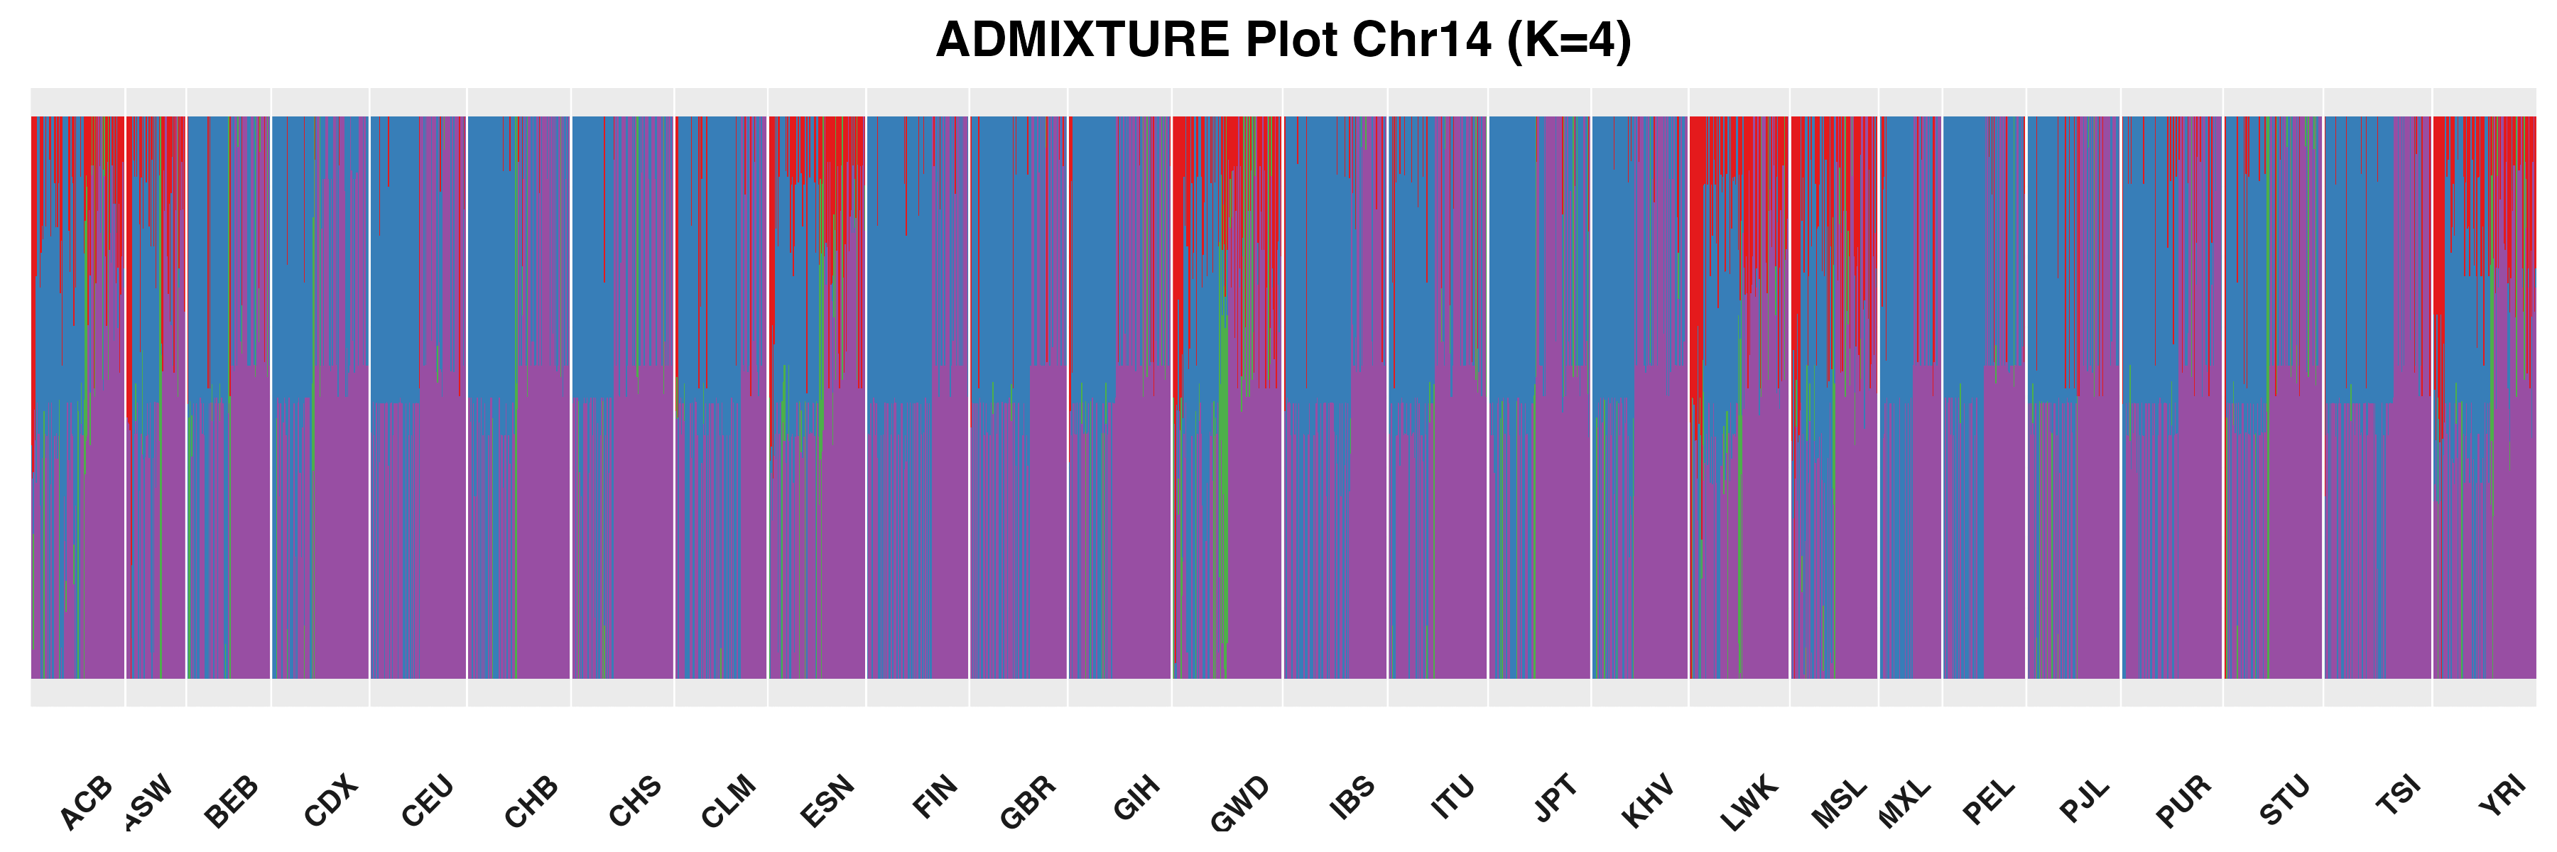
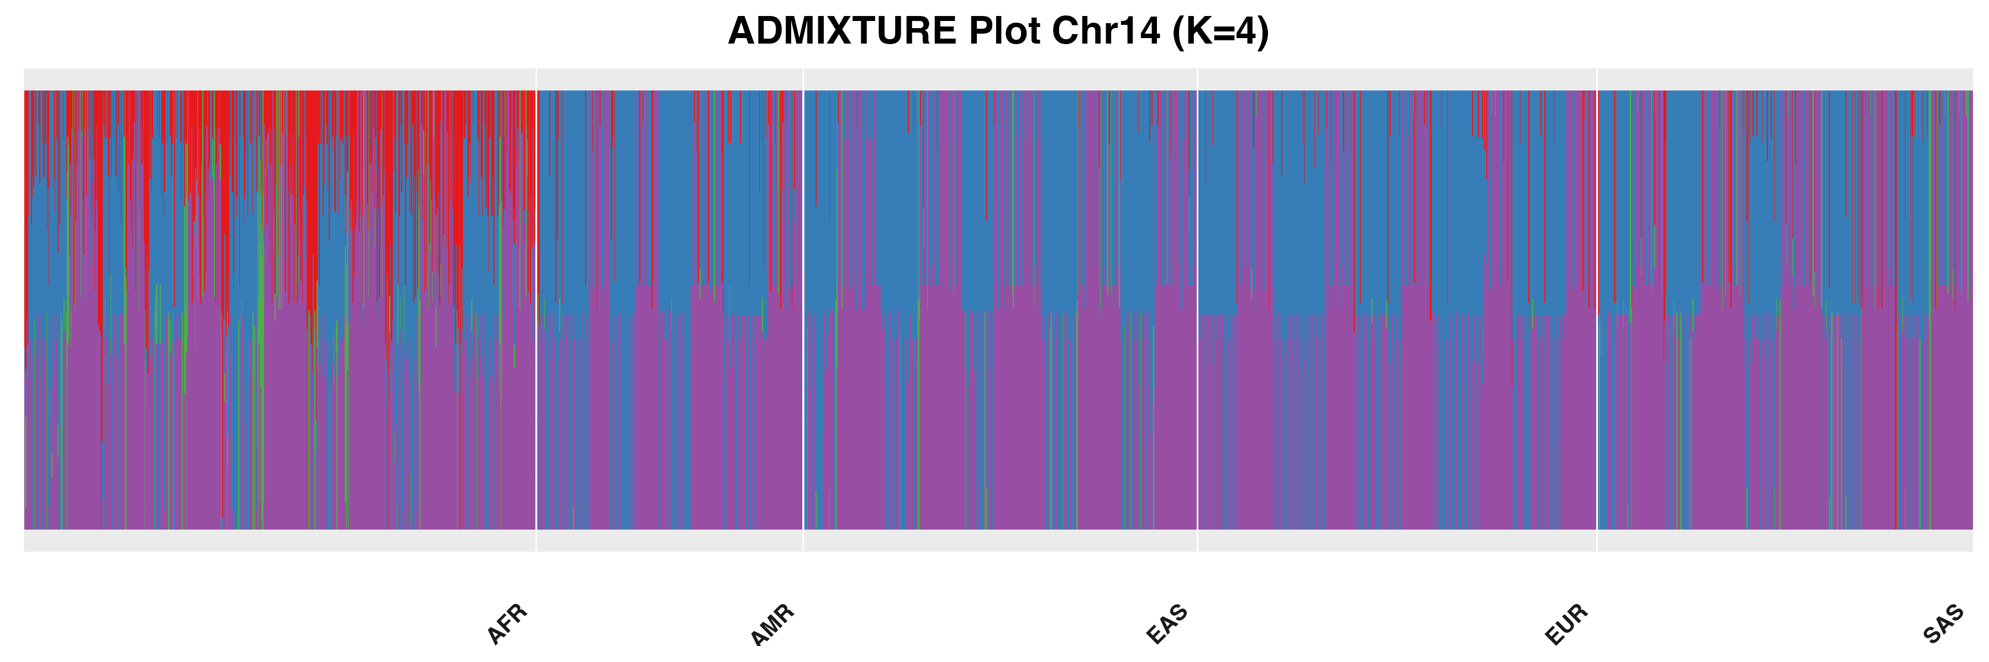
Results: ADMIXTURE
Most individuals are dominated by only two components (purple and blue).
Slightly more red observed in AFR, but still no distinct population clusters.
Suggests low between-population differentiation at this locus.
Notes:
CV error (K=2): 0.02910
CV error (K=3): 0.02444
CV error (K=4): 0.02380 -> Best
CV error (K=5): 0.02840
CV error (K=6): 0.03010

Slide 15
Results: ADMIXTURE
highly mixed ancestry components across all populations.
No clear population-specific clustering is visible.
Suggests low between-population differentiation at all loci.
Too few SNPs and insufficient variation in this region to detect population structure.
Notes:
“Although we hypothesized that 3 ancestry groups might be relevant for cilantro perception, our ADMIXTURE analysis showed no stable structure at K=3 or other values. This is likely due to the small number of SNPs and the fact that the analyzed genes do not capture strong population-level differentiation.”

Slide 16
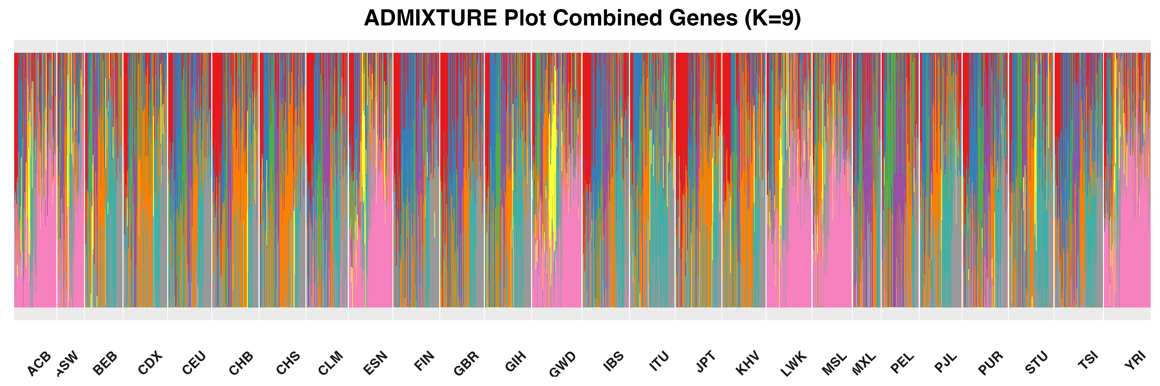
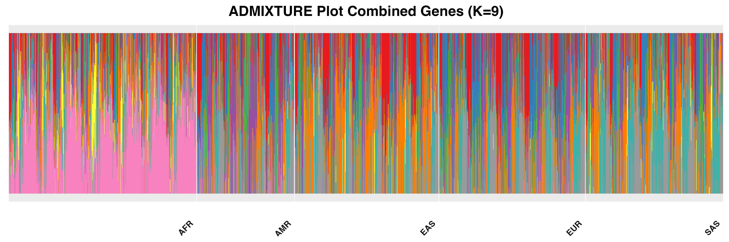
Results: ADMIXTURE
still shows no clear ancestry patterns or continental clusters
All populations are highly admixed across clusters
Combining genes increased SNP number, but not enough to overcome the noise
Notes:
CV error (K=2): 0.03327
CV error (K=3): 0.02968
CV error (K=4): 0.02885
CV error (K=5): 0.02771
CV error (K=6): 0.02672
CV error (K=7): 0.02569 -
CV error (K=8): 0.02583
CV error (K=9): 0.02563 -> Best
CV error (K=10): 0.02604

Slide 17
Discussion
The combined PCA shows some subtle grouping, but not enough for strong conclusions.
None of the individual genes or the combined dataset showed clear ancestry patterns in ADMIXTURE.
PCA & ADMIXTURE is better suited for genome-wide data or large SNP sets.

Slide 18
Outlook
ADMIXTURE and PCA
Enables exploration of genetic variation between populations by visualizing ancestry proportions
Applications in predicting population distribution of disease markers
are powerful tools, but only when used with large-scale, genome-wide data.
For small genomic regions or specific traits like cilantro perception, other methods are more appropriate, such as:
Genome-wide association studies (GWAS)
Allele frequency comparisons
Olfactory receptors are highly variable in the human population (SNPs, Copy number, Pseudogenes) but have high sequence similarity among each other.
This could lead to biases against SNPs in these regions due to filtering and sequencing methods and misrepresentation of the regions in the 1000 Genome project.
Notes:
Pseudogene: DNA sequence resembling a gene but has been mutated into an inactive form over the course of evolution
Sequencing & analysis bias: ▸ SNPs in these regions often get filtered out or misaligned due to:
Read mapping errors
Ambiguous alignment to multiple OR gene copies
Low-confidence variant calls
-> one must compare our sequence to well known, well sequenced areas of the same size to make that statement
Key Difference
Allelic frequency studies are SNP-focused: they look at variant distribution.
Admixture analysis is genome-wide and individual-focused: it estimates ancestry makeup.

Slide 19

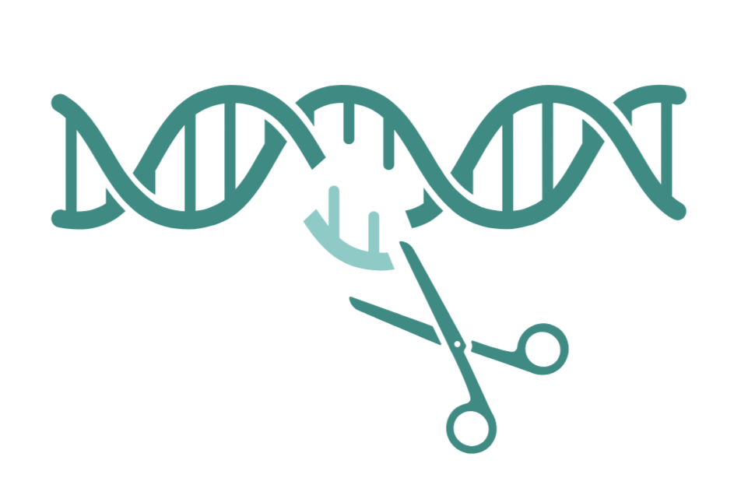


If you don´t like cilantro try:
AGAIN

Slide 20
Sources
Liu, CC., Shringarpure, S., Lange, K., Novembre, J. (2020). Exploring Population Structure with Admixture Models and Principal Component Analysis. In: Dutheil, J.Y. (eds) Statistical Population Genomics. Methods in Molecular Biology, vol 2090. Humana, New York, NY. https:doi.org/10.1007/978-1-0716-0199-0_4
https://www.23andme.com/en-int/genetic-science/ Accessed 01.05.2025
https://www.uniprot.org/uniprotkb/Q9NYW7/entry Accessed 01.05.2025
https://www.uniprot.org/uniprotkb/Q8IXE1/entry#function Accessed 01.05.2025
Eriksson, N., Wu, S., Do, C.B. et al. A genetic variant near olfactory receptor genes influences cilantro preference. Flavour 1, 22 (2012). https://doi.org/10.1186/2044-7248-1-22
Mauer, L. K. Genetic Determinants of Cilantro Preference. MSc thesis, Univ. Toronto https://tspace.library.utoronto.ca/bitstream/1807/31335/1/Mauer_Lilli_K_201108_MSc_Thesis.pdf (2011).
Callaway, E. Soapy taste of coriander linked to genetic variants. Nature (2012). https://doi.org/10.1038/nature.2012.11398
PCA plots were created in R. Population Distribution plots were created with Admixture. Cartoons were created in Biorender.
C. Trimmer et. Al. Genetic variation across the human olfactory receptor repertoire alters odor perception, Proc. Natl. Acad. Sci. U.S.A. 116 (19) 9475-9480, https://doi.org/10.1073/pnas.1804106115 (2019).
Notes:
Based on this https://link.springer.com/protocol/10.1007/978-1-0716-0199-0_4

Slide 21
Thesis Genetic Determinants of Cilantro Preference
Toronto Nutrigenomics and Health Study Participants (n = 1,639; 1,117 women and 522 men) which is a cross-sectional study investigating gene-diet interactions and biomarkers of chronic disease, as well as genetic determinants of eating behaviors.
Subjects were between 20 and 29 years of age
Excluded: pregnant or breastfeeding, non-english speakers, or who did not provide a 12- hour fasting venous blood sample, Smokers (n = 105), Subjects with any missing data (n = 10),Subjects who listed more than one ethnicity (n=143) or any group with fewer than 20 subjects were excluded from the current analyses
ethnocultural groups (based in self-identification): six groups (Caucasian, n = 581; East Asian, n = 540; South Asian, n = 165; Middle Eastern, n =36; African descent, n = 32; and Hispanic, n = 27).
After exclusions, the final sample population consisted of 1,381 subjects (962 women and 419 men).
East Asians and Caucasians had the highest prevalence of cilantro dislikers
genome-wide scans were performed using an Affymetrix 6.0 chip. A totalof 16 SNPs reached GWAS significance (p<5.5x10-6).
SNPs: OR4N5 chr14 and TAS5R2 chr 5
75% of individuals homozygous for the minor allele of both SNPs reported disliking, whereas 0% of subjects homozygous for the major allele of both SNPs reported disliking
Notes:
https://utoronto.scholaris.ca/server/api/core/bitstreams/8e66bc69-7dd0-493b-8268-49d4f658de2b/content

Slide 22
Thesis Genetic Determinants of Cilantro Preference
At the SNP level, markers eliminated first were those with call rates less than 95% (16,781 SNPs). Hardy-Weinberg equilibrium (HWE) was then assessed, and SNPs (30,711) with HWE P values less than 1×10-8 were excluded, as this suggests that they are not in HWE in this population.
Hardy-Weinberg Equilibrium (HWE) Filter: genotype frequencies should follow expected patterns if the population is not evolving (no selection, mating is random, etc.).
Notes:
Call rate filter:
Threshold: SNPs with less than 95% call rate (i.e., genotypes missing in more than 5% of people) were removed to not bias
HWE Threshold: SNPs with a P-value < 1×10⁻⁸ were removed.
A very small p-value means the SNP violates HWE, likely due to genotyping error, population structure, or selection.
These filters help clean the dataset by removing SNPs that are either unreliable or biologically inconsistent in this population, so the final analysis is more accurate.

Slide 23
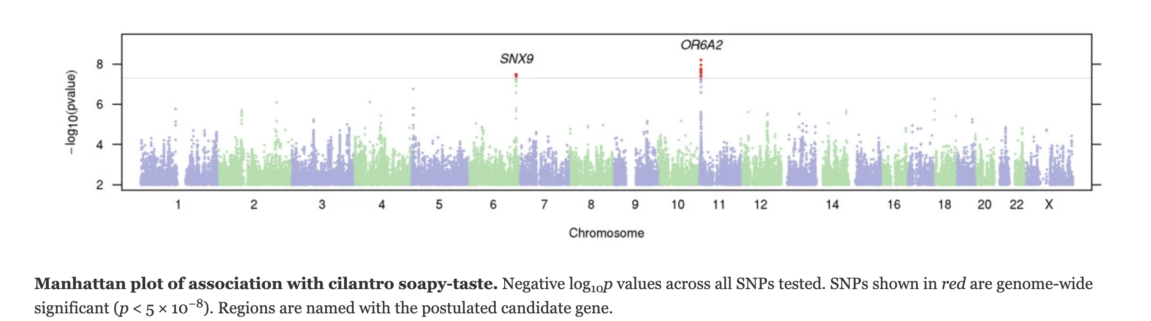
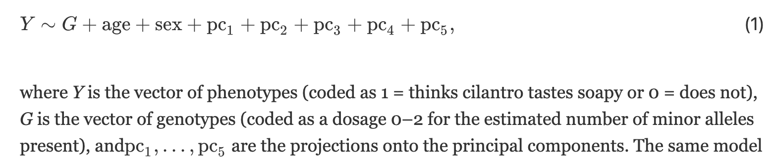
A genetic variant near olfactory receptor genes influences cilantro preference
SNP, rs72921001 (p = 6.4 × 10⁻⁹, odds ratio 0.81 per A allele), lies within a cluster of olfactory receptor genes on chromosome 11. Among these olfactory receptor genes is OR6A2, which has a high binding specificity for several of the aldehydes that give cilantro its characteristic odor. We also estimate the heritability of cilantro soapy-taste detection in our cohort, showing that the heritability tagged by common SNPs is low, about 0.087.
In both the GWAS set and the replication set, all participants were of European ancestry.
On the 23andMe website, participants contribute information through a combination of research surveys (longer, more formal questionnaires) and research ‘snippets’ (multiple-choice questions appearing as part of various 23andMe webpages). In this study, participants were asked two questions about cilantro via research snippets:
‘Does fresh cilantro taste like soap to you?’ (Yes/No/I’m not sure)
‘Do you like the taste of fresh (not dried) cilantro?’ (Yes/No/I’m not sure)
Subjects were genotyped on one or more of three chips, two based on the Illumina HumanHap550+ BeadChip and the third based on the Illumina OmniExpress+ BeadChip (San Diego, CA, USA). The platforms contained 586,916, 584,942, and 1,008,948 SNPs. Totals of 291, 5,394, and 10,184 participants (for the GWAS population)
logistic regression model:

Slide 24
23andMe
Autosomal analysis, genotyping based on SNPs
Samples that yield sufficient quantities of DNA are genotyped on our custom SNP chip (or microarray).
This process is performed in batches of approximately 96 samples. We monitor the process to make sure it is going as expected.
-> so NO WES or WGS, only SNPs of interest in array-based methods
Notes:
https://www.23andme.com/en-int/genetic-science/

Slide 25
Whole Chromosome 11 PCA
Whole Chromosome
Nothing inferable about cilantro anymore
We see SNP variance between the superpopulations
Notes:
Eigenvectors define the new coordinate system.
Eigenvalues tell you how important each new axis is.

Slide 26
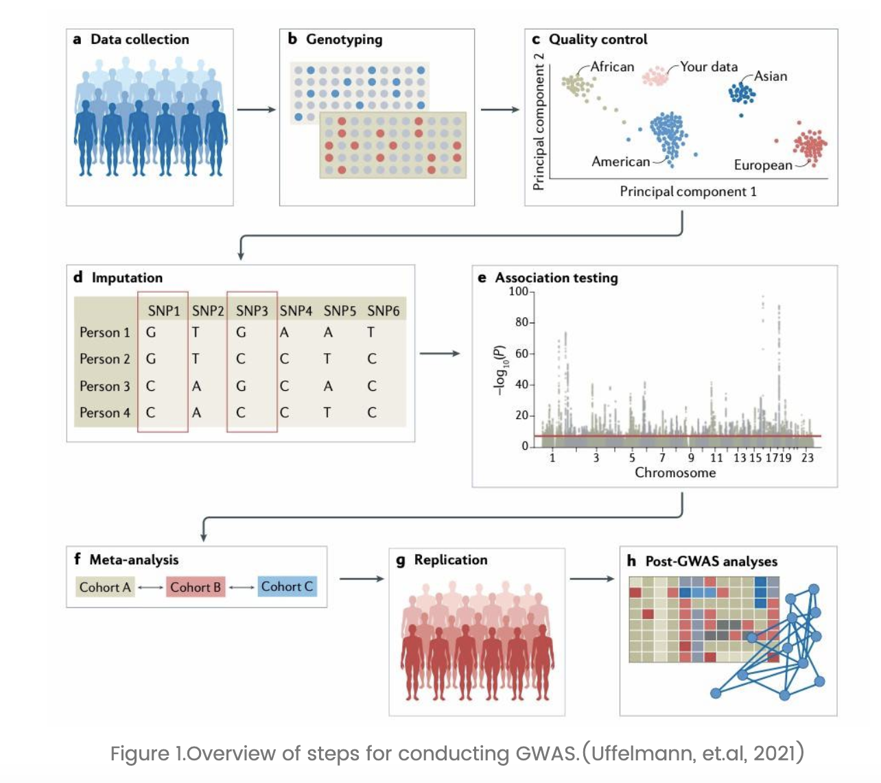
GWAS Workflow
https://www.cd-genomics.com/resource-gwas-vs-whole-genome-sequencing.html 02.05.2025

Slide 27
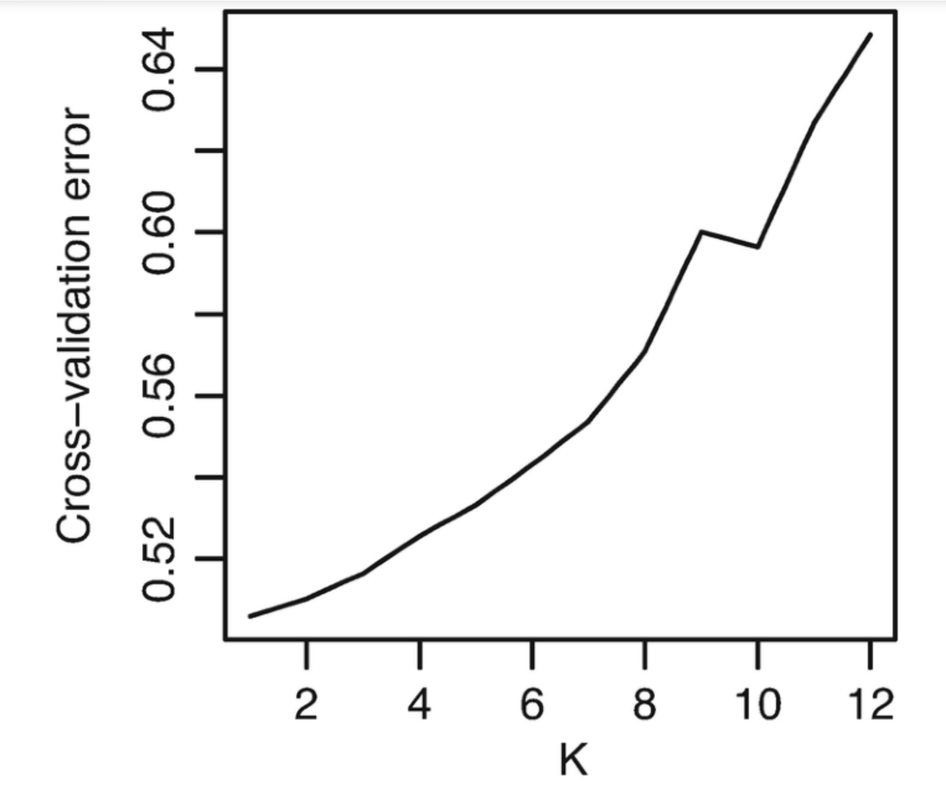
Cross-Validation
How to choose the perfect K (ancestral populations)
Accurate fitting without overfitting
computed as the negative log-likelihood
Smaller error = better fit
But also visually inspect the barplots to decide on perfect K
"The selection of K is a difficult problem to automate in a way that is robust."
cross-validation error suggests a single source population can model the data adequately and larger values of K lead to over-fitting

